Slide 1

AWS API Gateway:
The Front Door to Scalable APIs
Unlocking the Power of Modern Application Connectivity

Slide 2
What is Amazon API Gateway?
Amazon API Gateway is a fully managed service provided by AWS that empowers developers to create, publish, maintain, monitor, and secure APIs at any scale. It acts as a robust front door for applications to access data, business logic, or functionality from your backend services.
Versatile API Support
Seamless Backend Integration
Simplified API Lifecycle
Supports various API types including REST APIs for stateless communication, HTTP APIs for high-performance, cost-effective APIs, and WebSocket APIs for real-time, stateful bidirectional communication.
Acts as a sophisticated gateway between your client applications and diverse backend services, such as AWS Lambda functions, applications running on Amazon EC2 instances, or even external on-premises web services.
Handles the heavy lifting of API management, allowing you to focus on your application's core logic. From deployment to retirement, API Gateway streamlines the entire API lifecycle.
This foundational service is crucial for building modern serverless and microservices architectures, providing a reliable and secure interface for all your digital interactions.

Slide 3
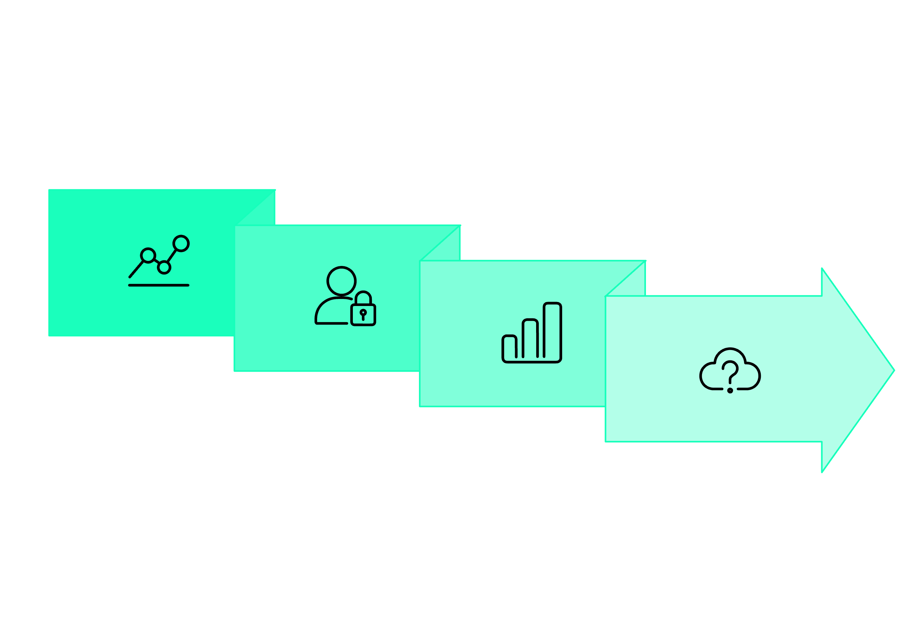




API Gateway Architecture: Simplifying API Management
API Gateway intelligently manages traffic, enhances security, and ensures optimal performance by integrating seamlessly with AWS's global infrastructure.
Authorization
Backend & Versioning
Traffic Management
Throttling & Monitoring
By offloading these critical functions, API Gateway allows your backend services to focus purely on business logic, leading to more resilient and performant applications.

Slide 4
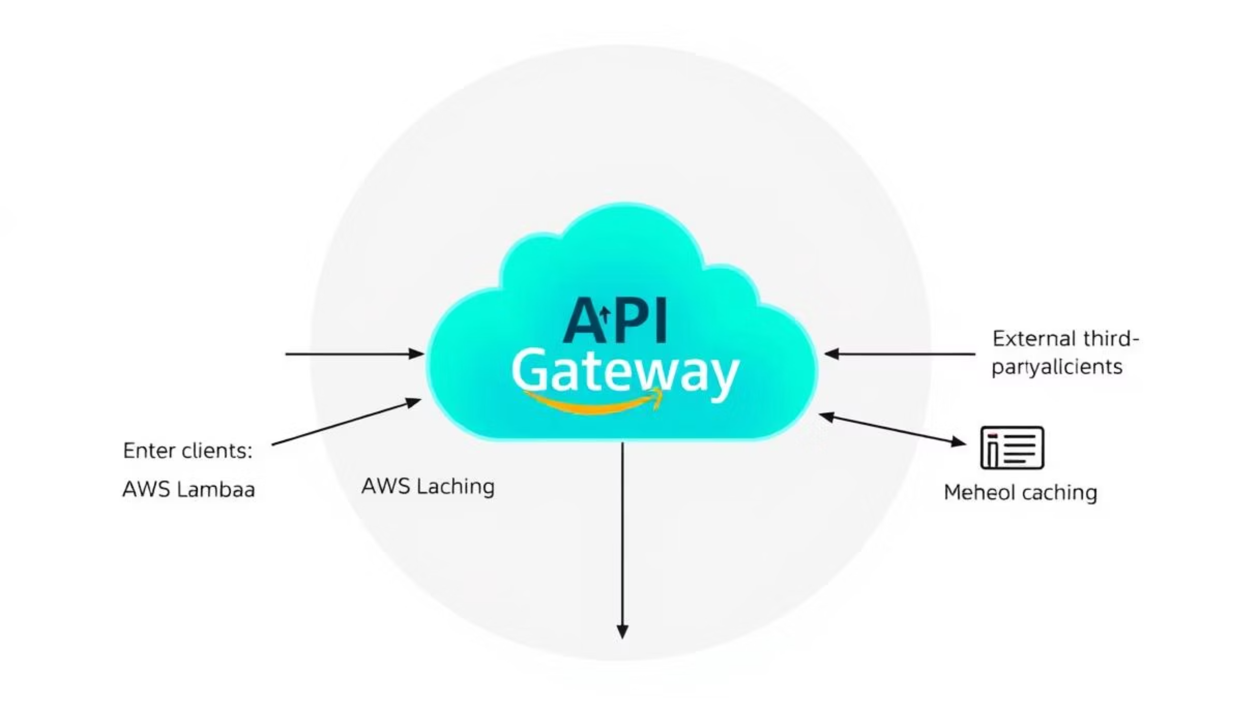
Dynamic Request Routing and Global Delivery
API Gateway effectively routes and processes client requests, ensuring efficient and secure communication with diverse backend services, all accelerated by CloudFront's global edge network.

Slide 5




Key Features That Power Your APIs
AWS API Gateway provides a comprehensive suite of features designed to make API creation and management effortless, secure, and highly scalable.
RESTful & WebSocket APIs
Flexible Authentication
Supports both traditional RESTful APIs (HTTP and REST) for request-response patterns and WebSocket APIs for real-time, bidirectional communication in applications like chat and live updates.
Offers multiple authentication mechanisms, including IAM policies for fine-grained access, Lambda authorizers for custom logic, Amazon Cognito for user management, and standard OAuth 2.0 and OpenID Connect for broader compatibility.
Canary Deployments
Custom Domains & WAF
Enables canary deployments to roll out new API versions safely by gradually shifting traffic to the new version, allowing for real-time monitoring and quick rollbacks if issues arise.
Supports custom domain names for brand consistency and integrates natively with AWS WAF (Web Application Firewall) to protect your APIs from common web exploits and bots.
These features collectively ensure that your APIs are not just functional, but also secure, robust, and easy to manage throughout their lifecycle.

Slide 6


Security & Governance Built In
AWS API Gateway offers a multi-layered approach to security and compliance, protecting your APIs and data from endpoint to backend.
AWS WAF Integration
Access Control
Natively integrates with AWS Web Application Firewall (WAF) to provide robust protection against common web exploits and bots, such as SQL injection and cross-site scripting (XSS), safeguarding your APIs at the edge.
Supports fine-grained access control using AWS Identity and Access Management (IAM) policies and Amazon Cognito user pools, allowing you to define precise permissions for who can access your API resources.
Audit & Compliance
Monitoring & Tracing
Ensures auditability and compliance readiness with integrations like AWS CloudTrail for logging API calls and AWS Config for monitoring resource configurations, maintaining a clear record of all API activities.
Provides end-to-end monitoring with Amazon CloudWatch for API metrics and logs, and AWS X-Ray for tracing requests through your API Gateway and integrated backend services, enabling quick troubleshooting.

Slide 7
Scalability & Performance at Any Scale
AWS API Gateway is engineered for high performance and elasticity, ensuring your APIs can handle fluctuating demand without manual intervention.
1M+
90%
100%
Concurrent Calls
Cost Efficiency
Global Reach
Automatically scales to handle hundreds of thousands of concurrent API calls without requiring pre-provisioning or warm-up, adapting effortlessly to peak loads.
Leverages a tiered pricing model, offering rates as low as $0.90 per million requests at the highest usage tiers, providing significant cost savings as your API usage grows.
Utilizes Amazon CloudFront's global edge network, caching API responses at edge locations worldwide to ensure the fastest possible response times for your users, regardless of their geographic location.
Additionally, API Gateway includes features like traffic throttling to protect your backend systems from being overwhelmed and caching to reduce latency and the load on your backend.

Slide 8
Real-World Use Cases
AWS API Gateway empowers a wide range of applications and architectures, from modern serverless apps to legacy system integrations.
Serverless Applications
Mobile & Web App Backends
Seamlessly integrates with AWS Lambda to create powerful serverless applications, handling millions of requests daily without managing any servers. Ideal for dynamic content, mobile backends, and data processing.
Provides secure, scalable, and low-latency API endpoints for mobile and web applications, ensuring fast data retrieval and submission. Includes features for user authentication and authorization, simplifying development.
Legacy System Modernization
Real-Time Applications
Acts as a modern facade for older, monolithic systems, allowing you to proxy HTTP requests through API Gateway. This enables integration with new applications and gradual modernization without re-architecting everything at once.
Leverages WebSocket APIs to enable real-time communication for interactive applications such as chat platforms, multi-player gaming, live dashboards, and streaming data updates.

Slide 9




Getting Started with AWS API Gateway
Embarking on your API development journey with AWS API Gateway is straightforward, offering multiple tools and resources to get you up and running quickly.
OpenAPI Specifications
Management Tools
Easily import existing APIs or export your API Gateway definitions using OpenAPI specifications (versions v2 & v3), facilitating collaboration and consistent API design across your teams.
Create and manage your APIs using the intuitive AWS Management Console, automate tasks with the AWS Command Line Interface (CLI), or integrate directly into your applications using the various AWS SDKs.
Hands-On Tutorials
Developer Portal
Dive in with comprehensive, step-by-step tutorials available for various scenarios, including building serverless web applications and integrating API Gateway into your DevOps pipelines.
Expedite the onboarding of third-party developers with an optional developer portal. This provides a self-service platform for API discovery, documentation, API key management, and SDK generation.
These resources ensure that both new and experienced developers can leverage API Gateway's full potential efficiently.

Slide 10

The Future of API Management with AWS API Gateway
AWS API Gateway stands as a cornerstone of modern cloud architecture, offering a unified, secure, and infinitely scalable platform for managing all your APIs. It's more than just a gateway; it's an enabler for innovation.
Unified Platform: A single, consolidated service to handle all API types, from RESTful to WebSockets, simplifying management and reducing operational overhead.
Continuous Innovation: AWS consistently adds new features, deeper integrations, and performance enhancements, ensuring API Gateway remains at the forefront of API management technology.
Empower Your Teams: Provides developers with the tools and confidence to build, deploy, and manage APIs efficiently at any scale, fostering agility and rapid development.
Ready to Unlock Your API Potential? Start Building Today with AWS API Gateway!

